Slide 1
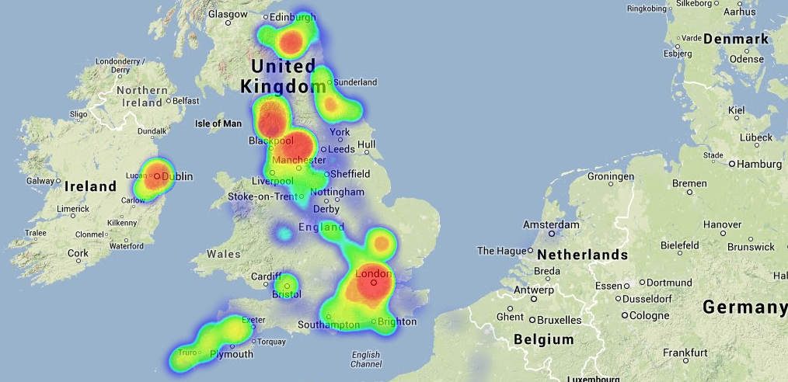
heatmap.js
Patrick Wied
4 years of Lat/Longs Jamie Aspinall

Slide 2

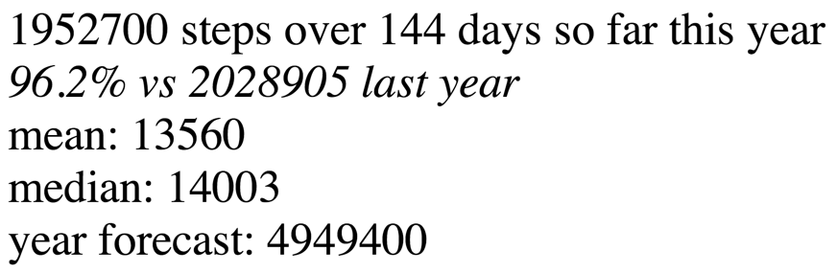



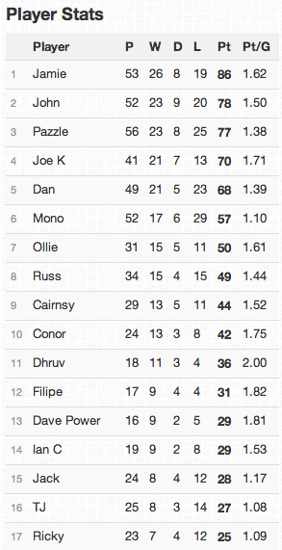
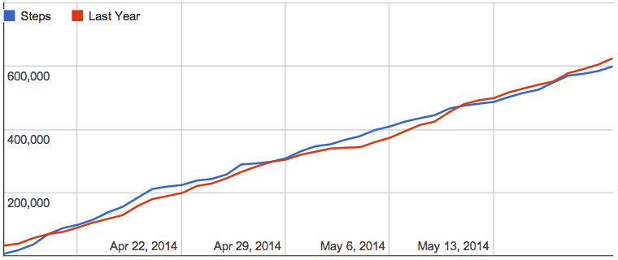
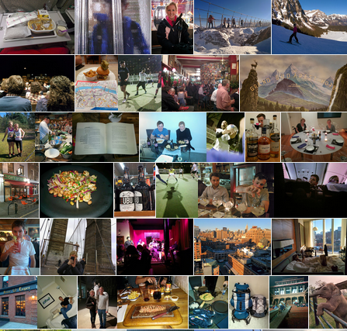
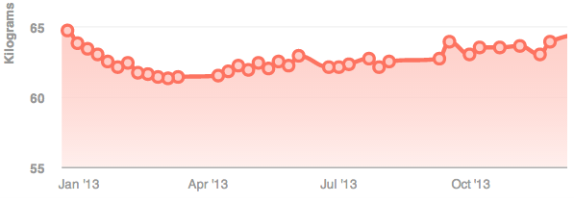

Slide 3
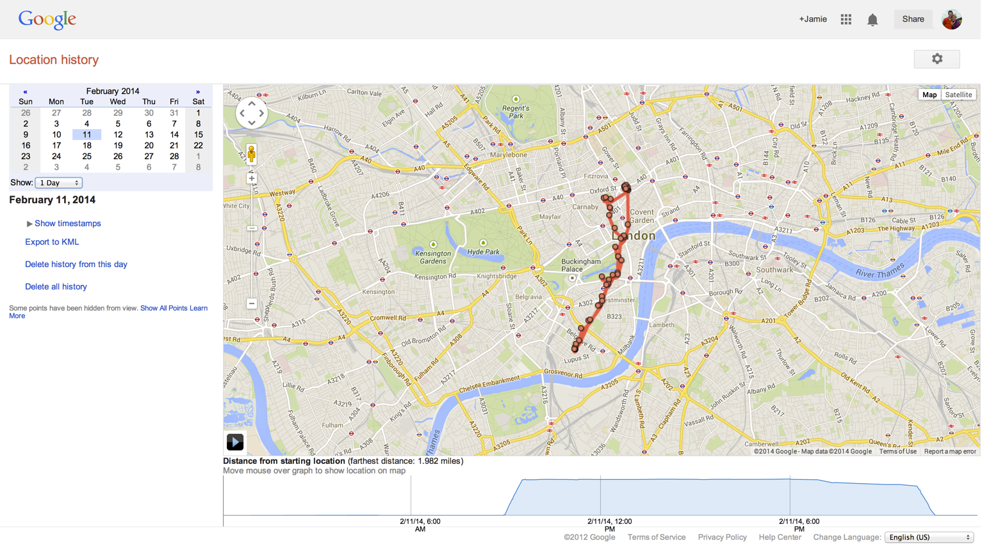

Slide 4
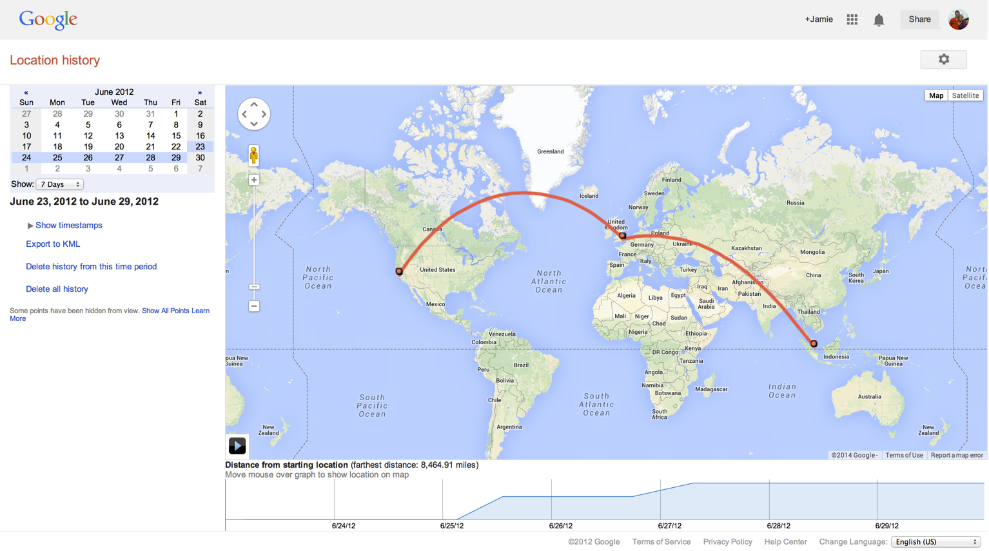

Slide 5
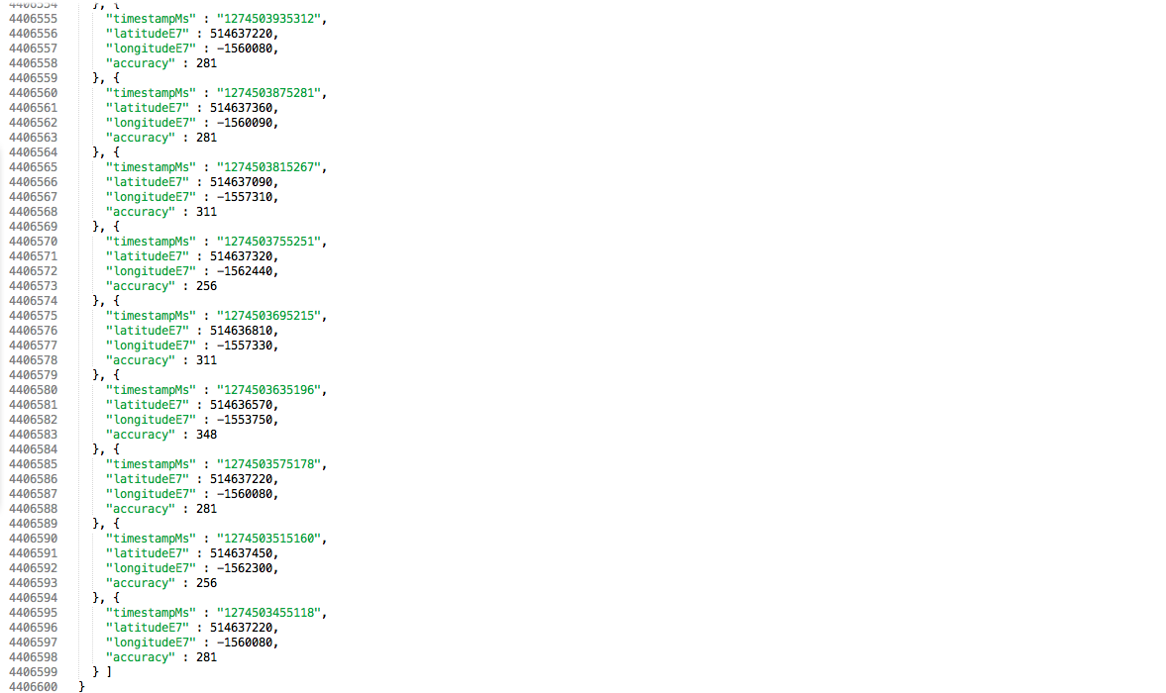
4 years of locations
4,400,000 lines of JSON, 100MB
600,000 data points
96% coverage of 1,400 days

Slide 6
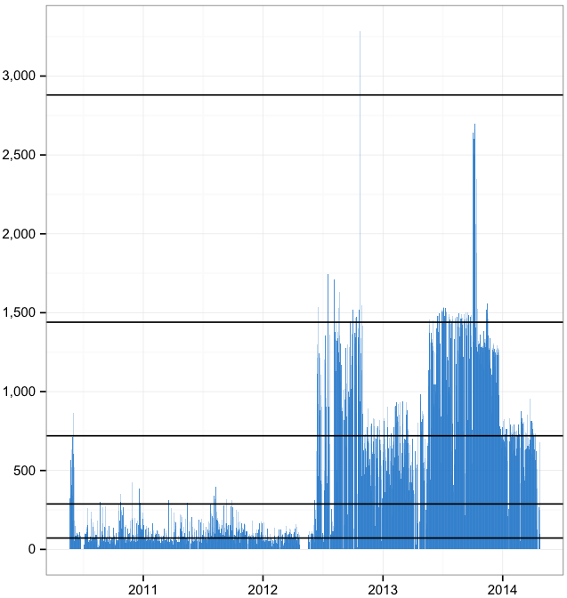
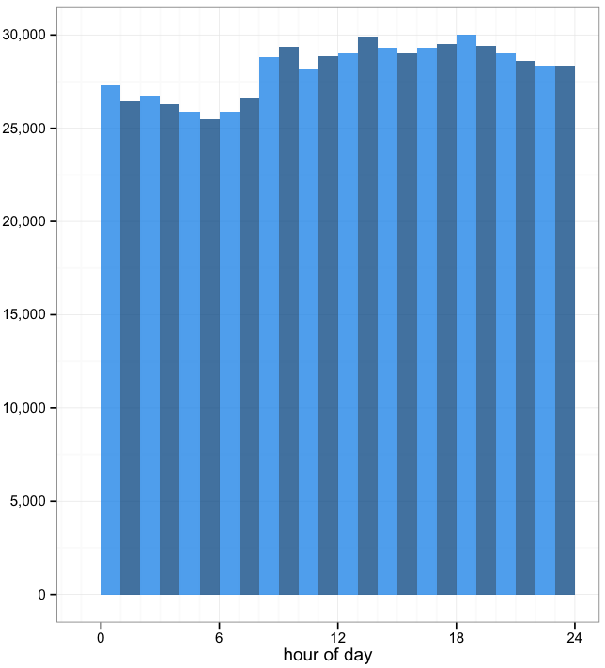
# data points per day
# data points per hour of day
every 30 seconds
every 1 min
every 2 mins
every 5 mins
every 20 mins

Slide 7
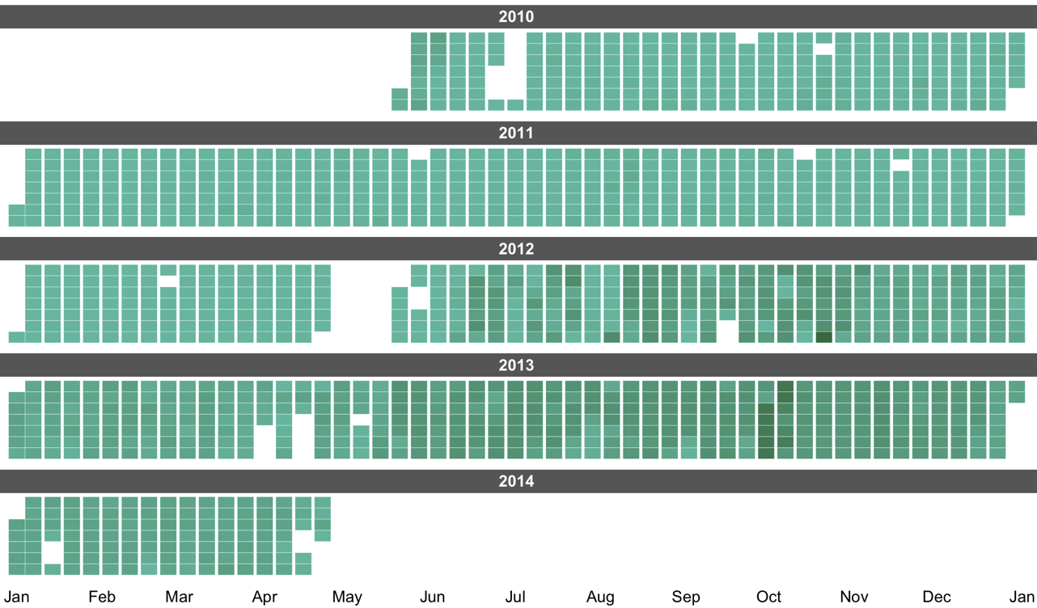
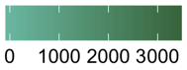
Mon
Tue
Wed
Thu
Fri
Sat
Sun
Mon
Tue
Wed
Thu
Fri
Sat
Sun
Mon
Tue
Wed
Thu
Fri
Sat
Sun
Mon
Tue
Wed
Thu
Fri
Sat
Sun
Mon
# daily data points
Tue
Wed
Thu
Fri
Sat
Sun

Slide 8
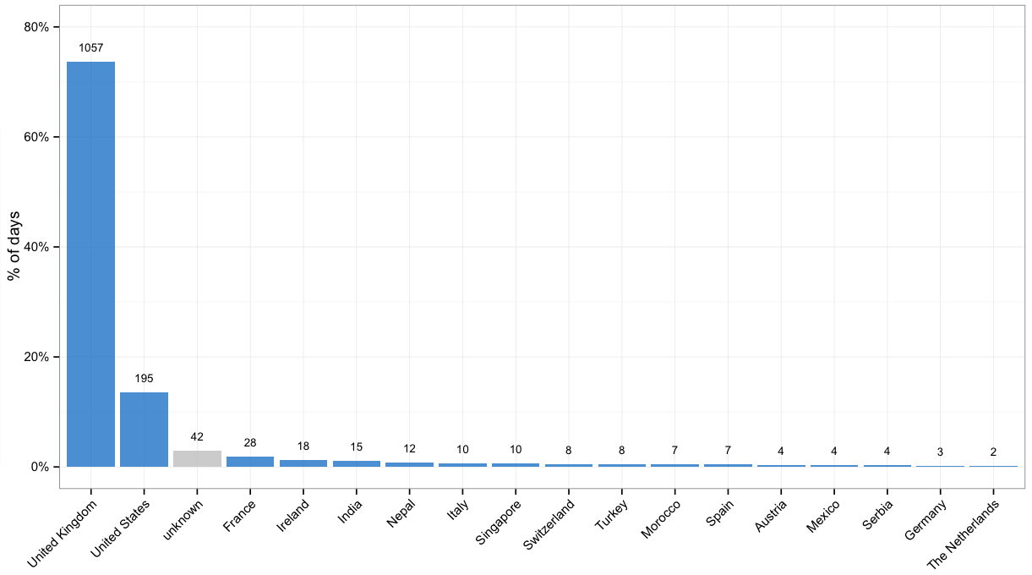
Google Maps API Web Services
Directions API
Distance Matrix API
Elevation API
Geocoding API
Time Zone API
Places API
https://maps.googleapis.com/maps/api/geocode /json?latlng=40.714224,-73.961452&...

Slide 9
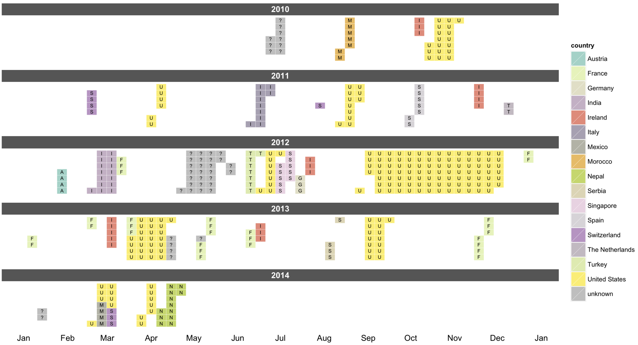
Mon
Tue
Wed
Thu
Fri
Sat
Sun
Mon
Tue
Wed
Thu
Fri
Sat
Sun
Mon
Tue
Wed
Thu
Fri
Sat
Sun
Mon
Tue
Wed
Thu
Fri
Sat
Sun
Mon
Tue
Wed
Thu
Fri
Sat
Sun

Slide 10
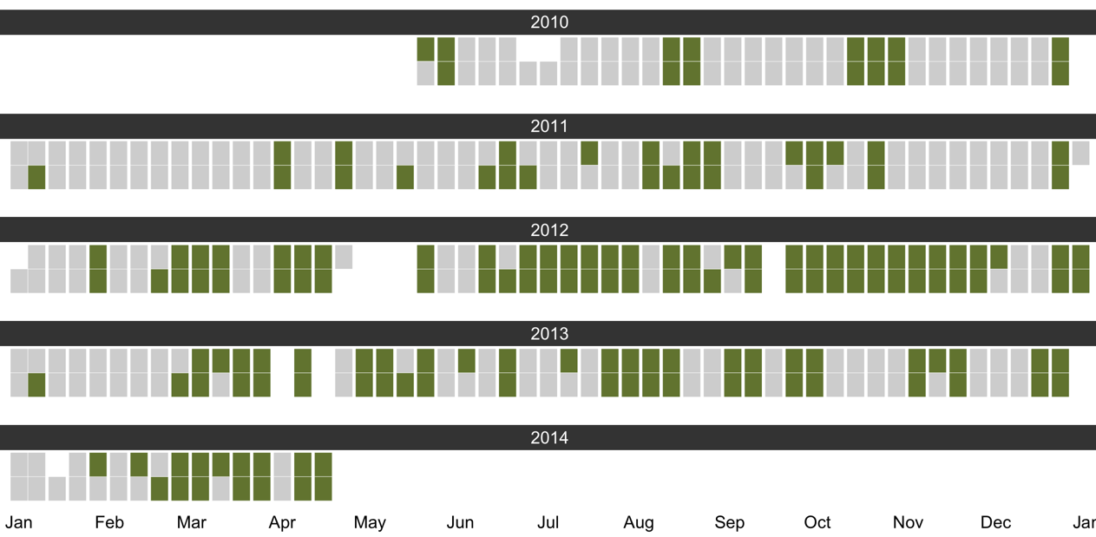
Escaped London :)
Stuck in London :(

Slide 11
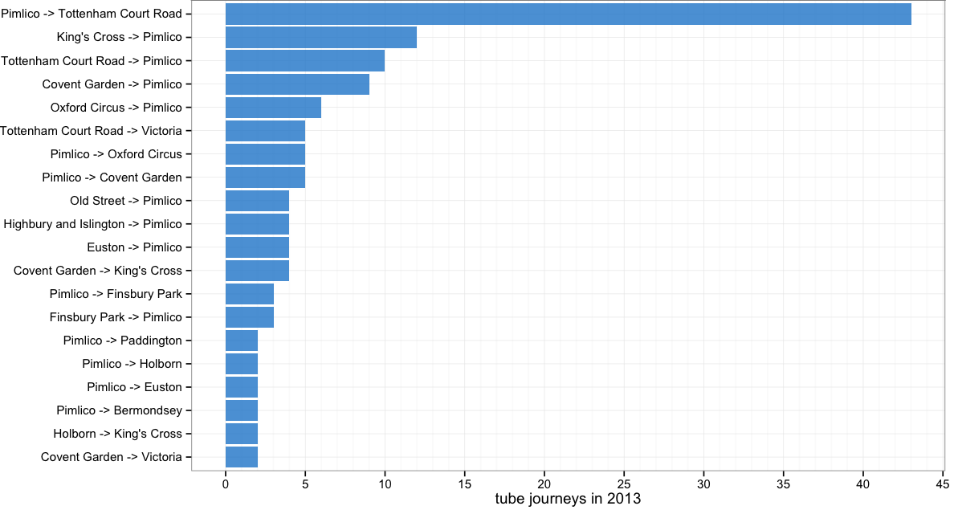


Slide 12
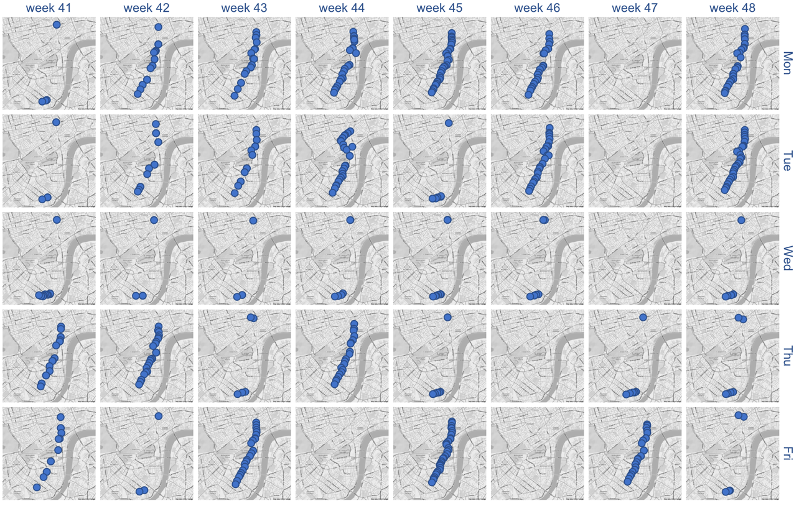

Slide 13
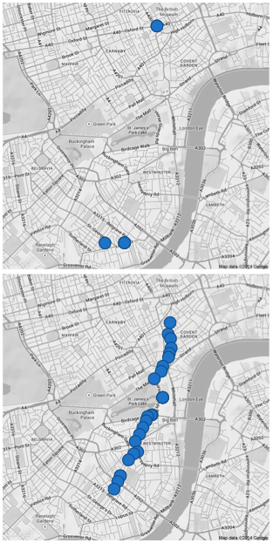
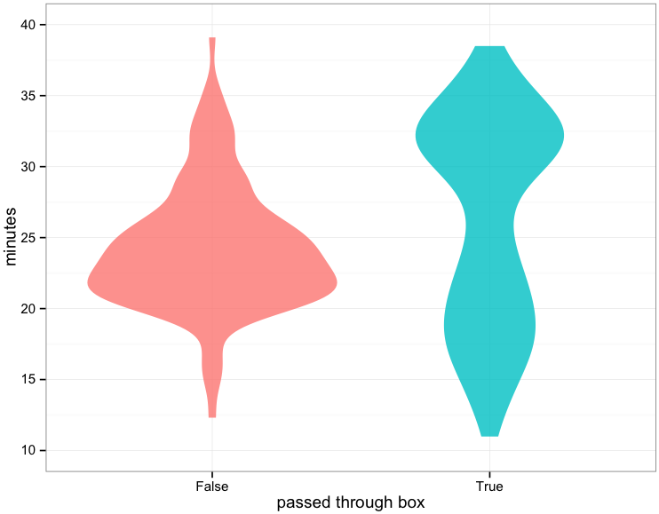
Walked
Tube
Ran,
Cycled

Slide 14
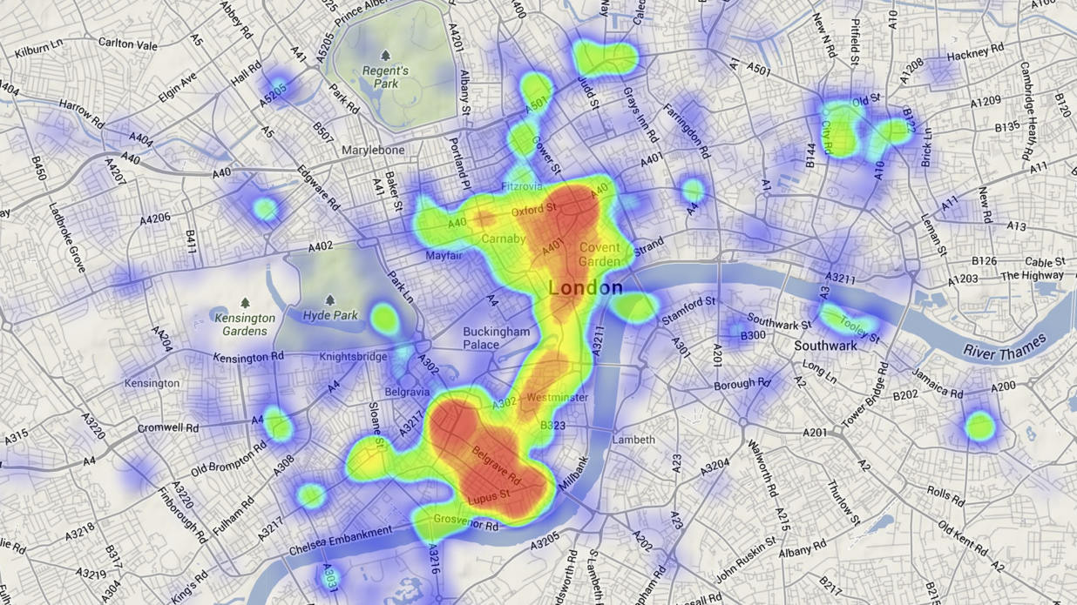
heatmap.js
Patrick Wied

Slide 15
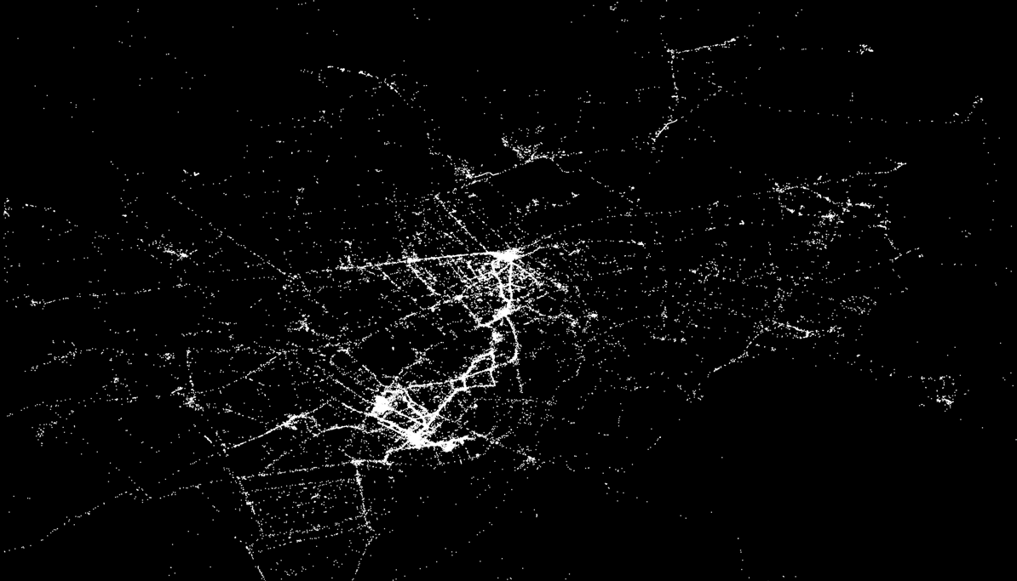

Slide 16
Upper
St
Kings X
Euston
Old St
Paddington
Oxford St
Work 1
Hyde Park
Trafalgar Sq
Green Park
Work 2
London Bridge
King’s Rd
Home
Climbing
Battersea Park

Slide 17
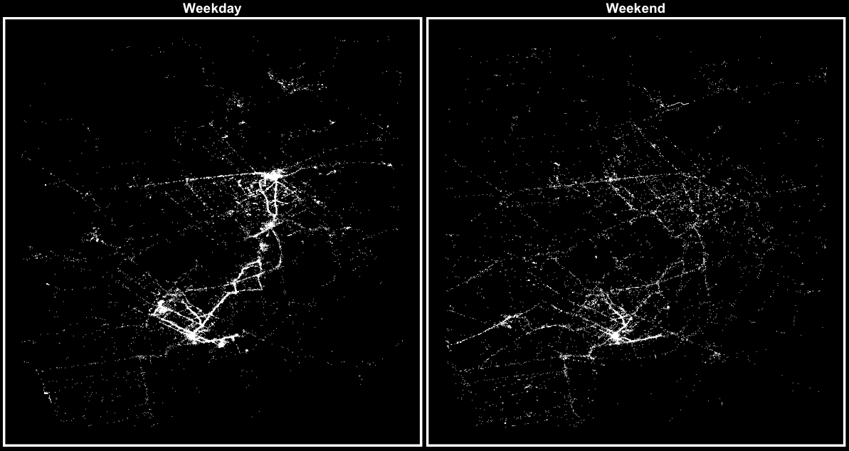

Slide 18
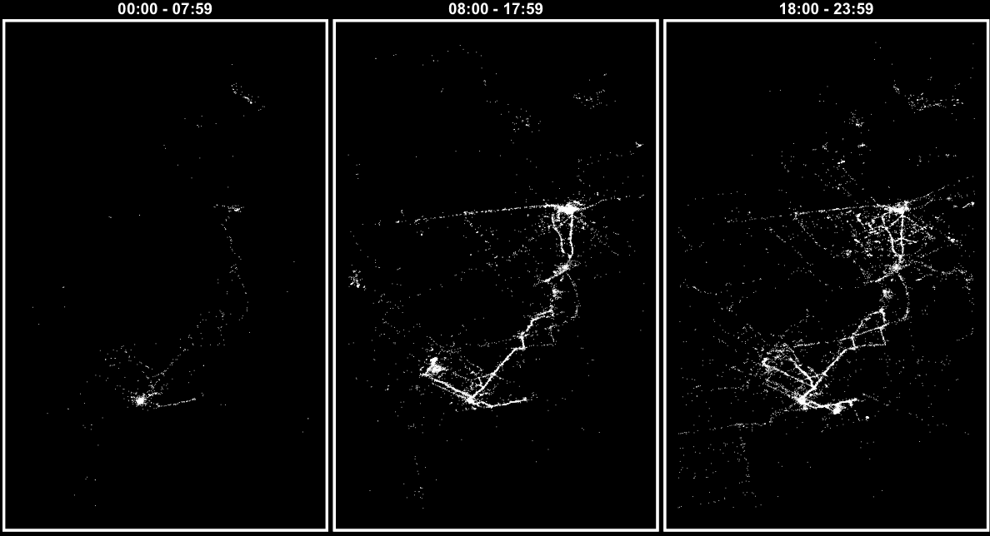

Slide 19
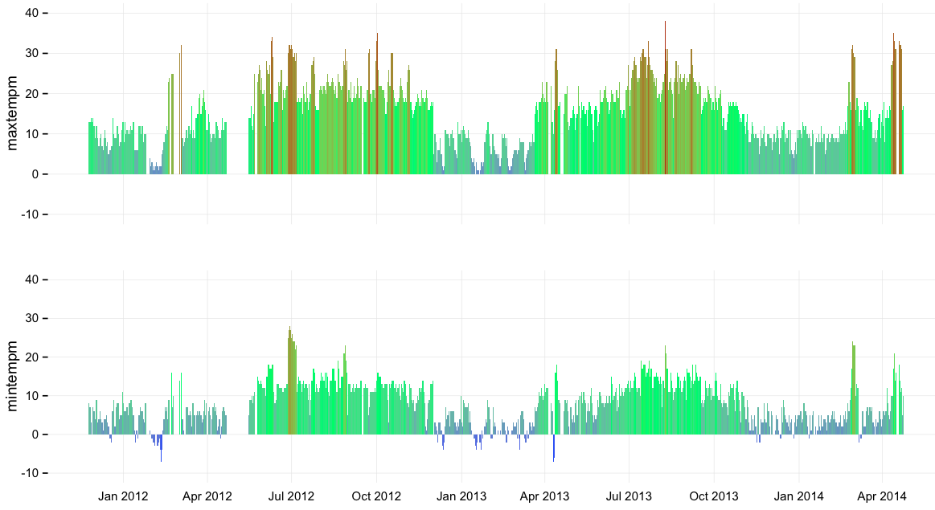

CA
Max Temp (c)
UK
Singapore
Min Temp (c)

Slide 20

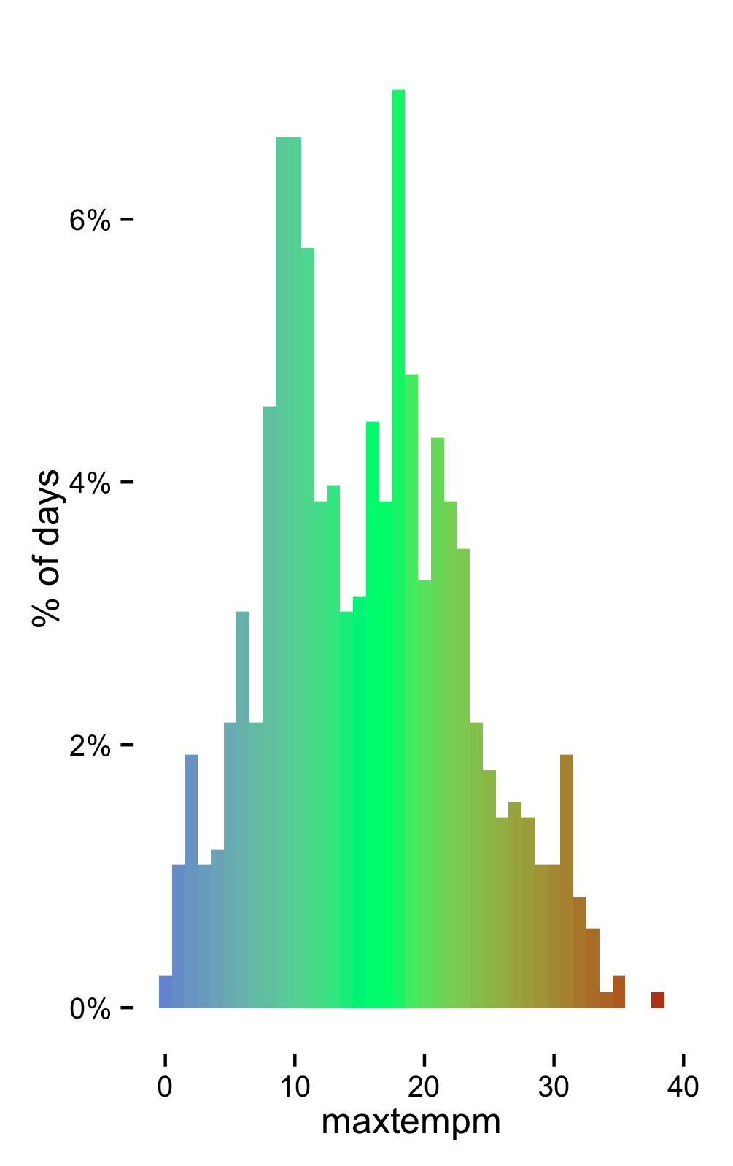
Belgrade 2013-08-09 38°

Slide 21
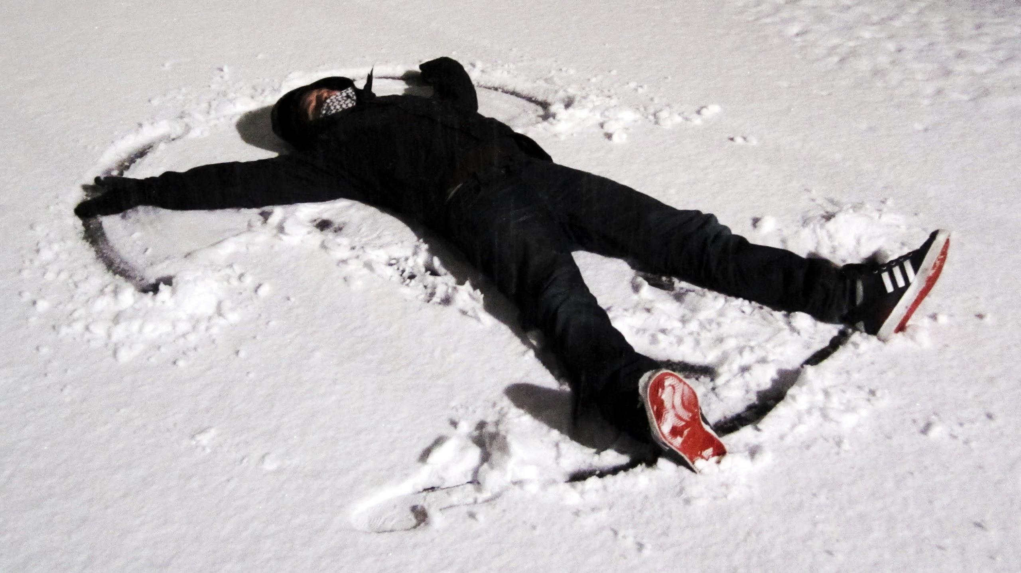
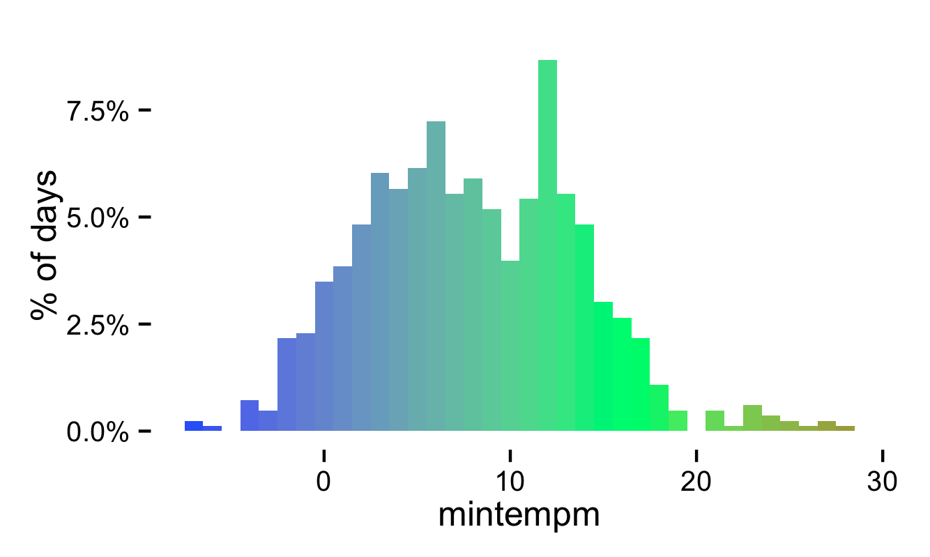
London 2012-02-11 -7°

Slide 22
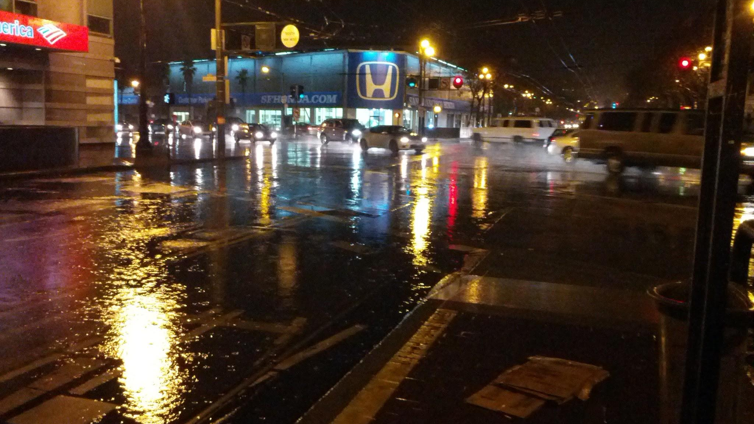
San Francisco
2012-11-30
50mm of rain

Slide 23
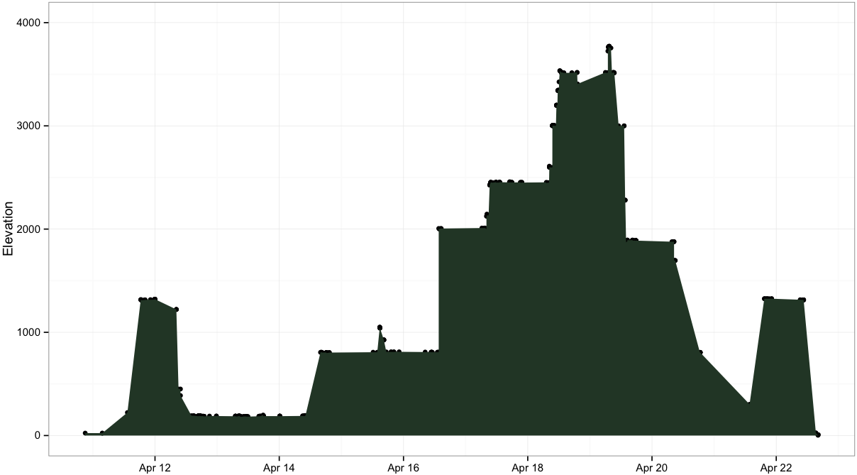
Another source of location data
Summit
Camp #3
= one photo in Nepal
Camp #2
Camp #1
Sidingh
Kathmandu
Kathmandu
Rafting
Pokhara
Pokhara
Chitwan NatPark

Slide 24

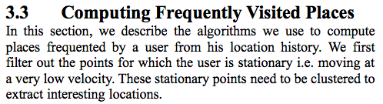
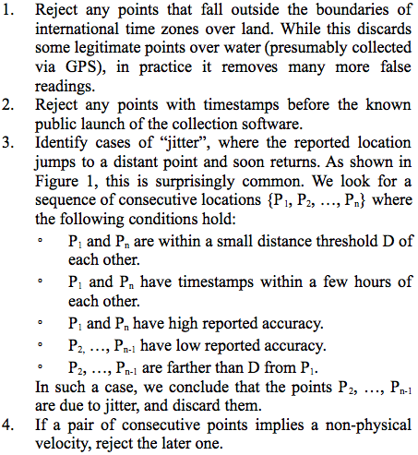
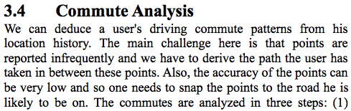
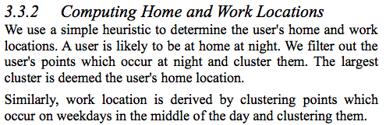

Slide 25
heatmap.js
Patrick Wied
Thank you

Slide 26
Appendix

Slide 27
Next steps
clustering
2 people’s data
fitbit correlations
calendar filling

Slide 28
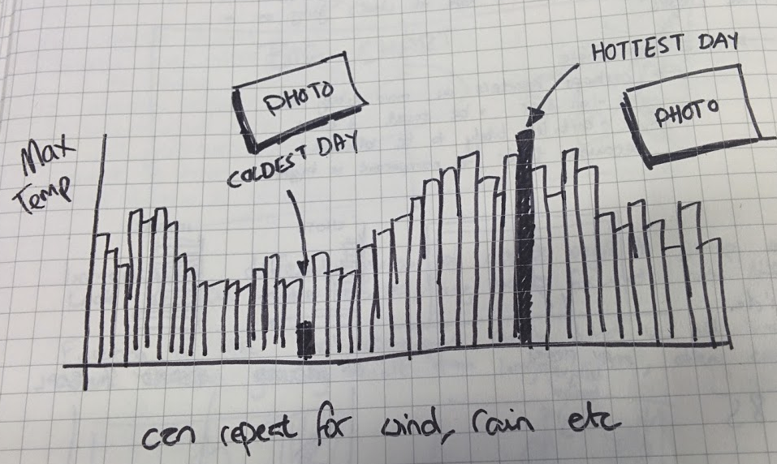
Weather
year in weather records
countries and temperature

Slide 29
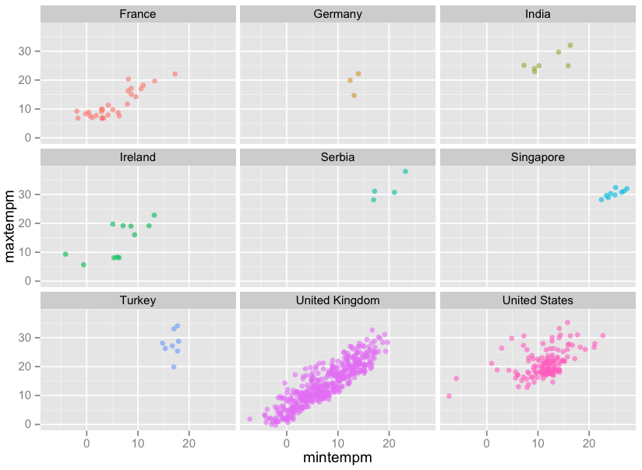
Weather
year in weather records
countries and temperature

Slide 30
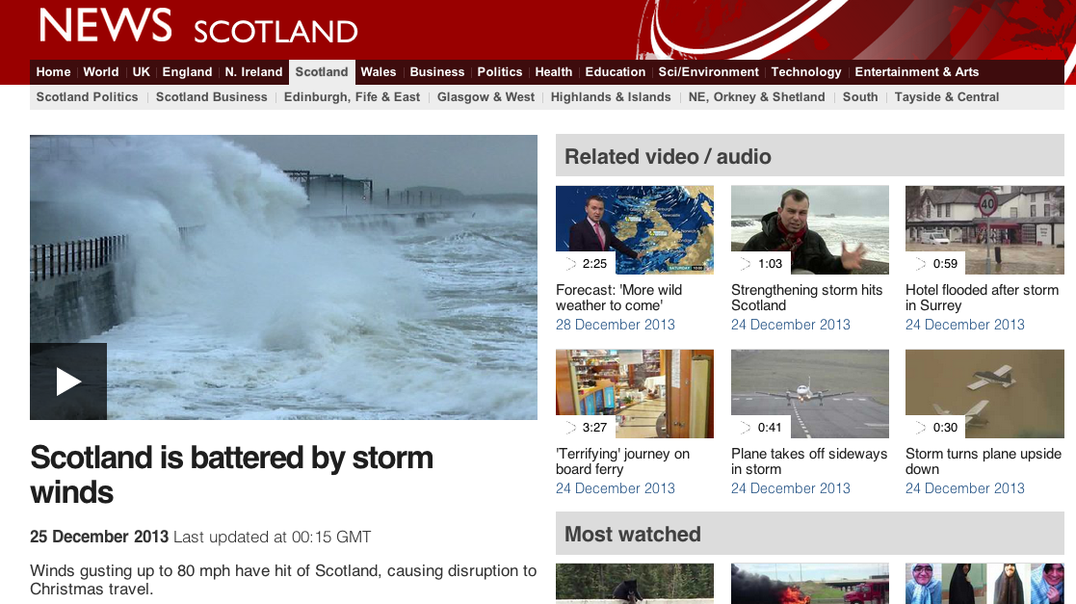
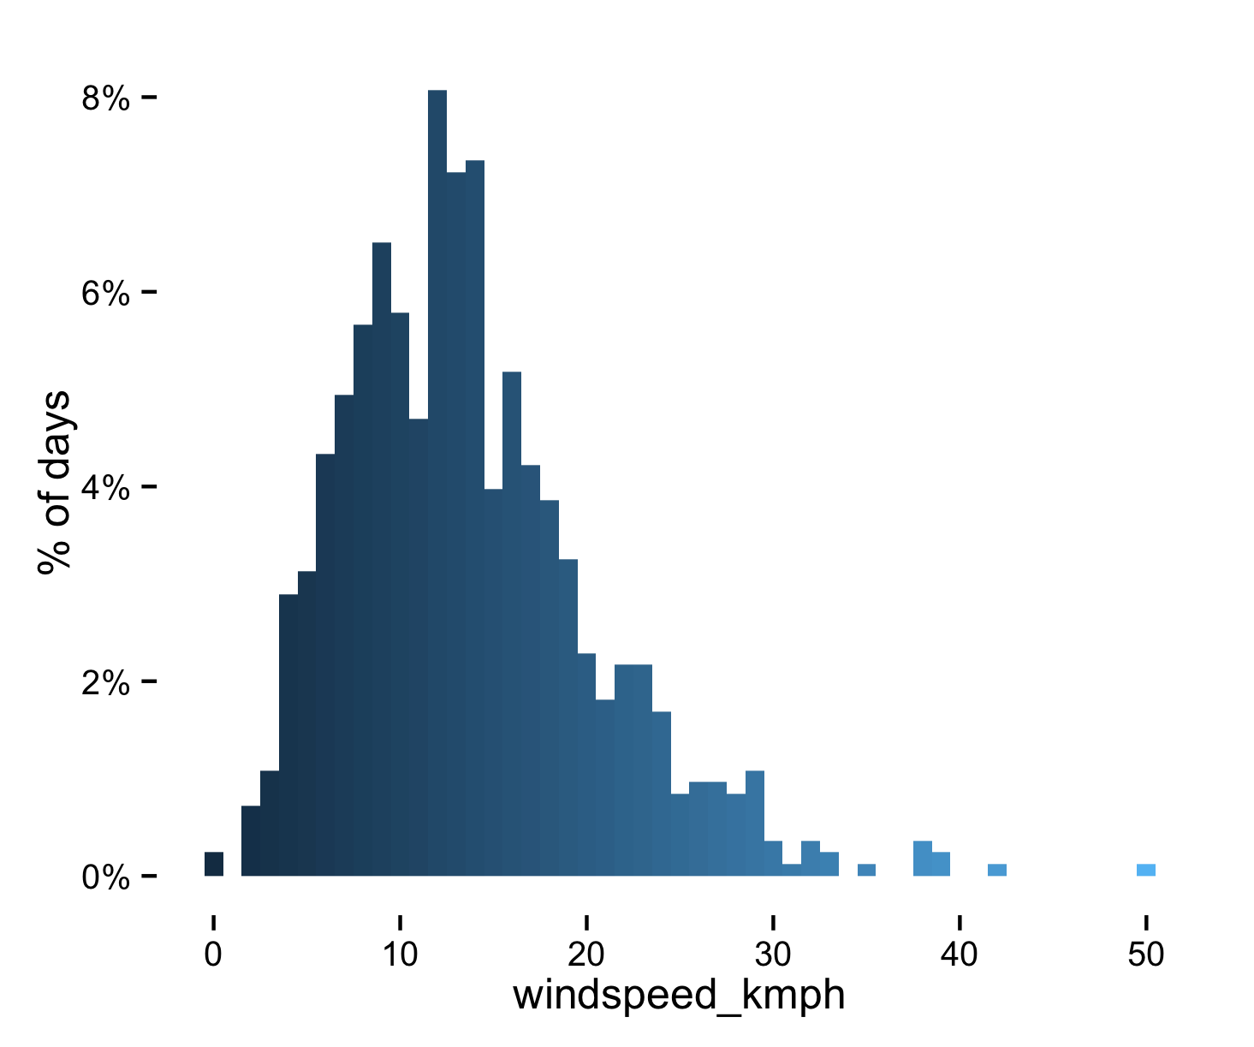
Scottish Borders 2013-12-27 50km/h

Slide 31
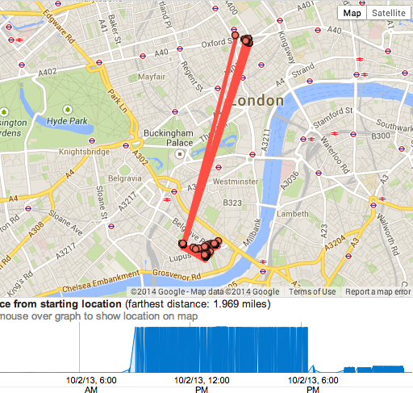
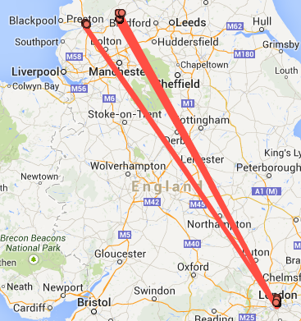
Some issues
>1,000,000 km/h

Slide 32
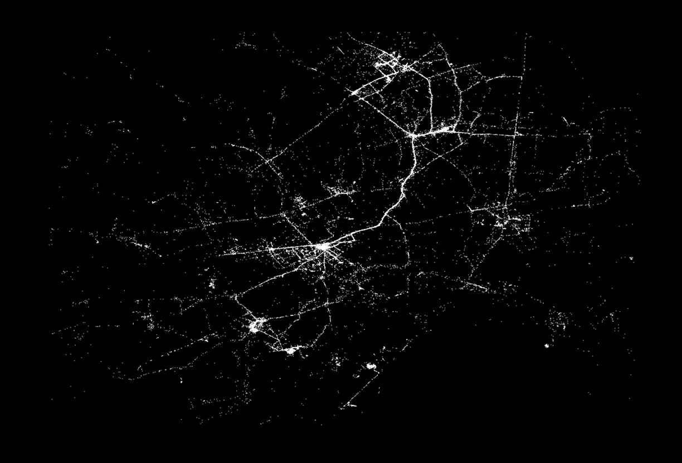
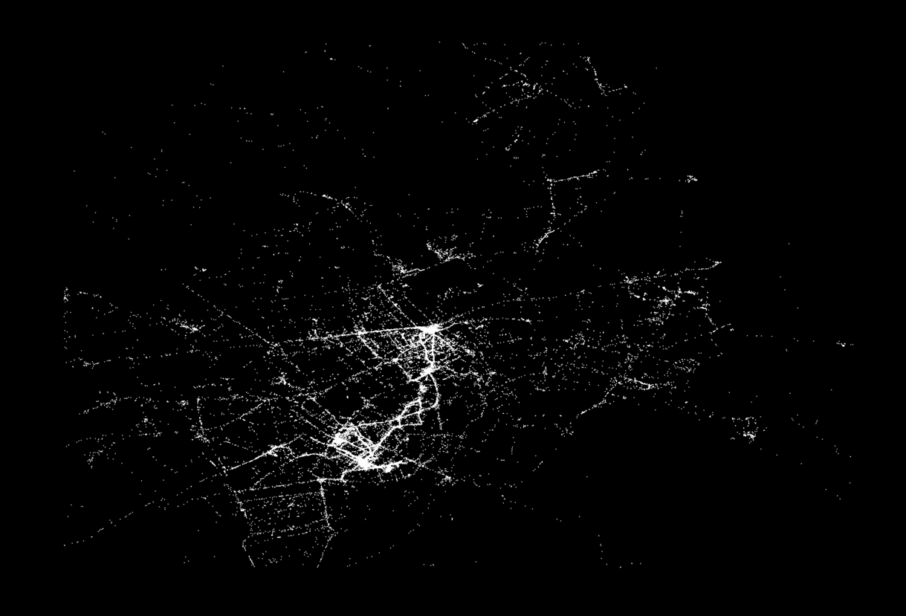
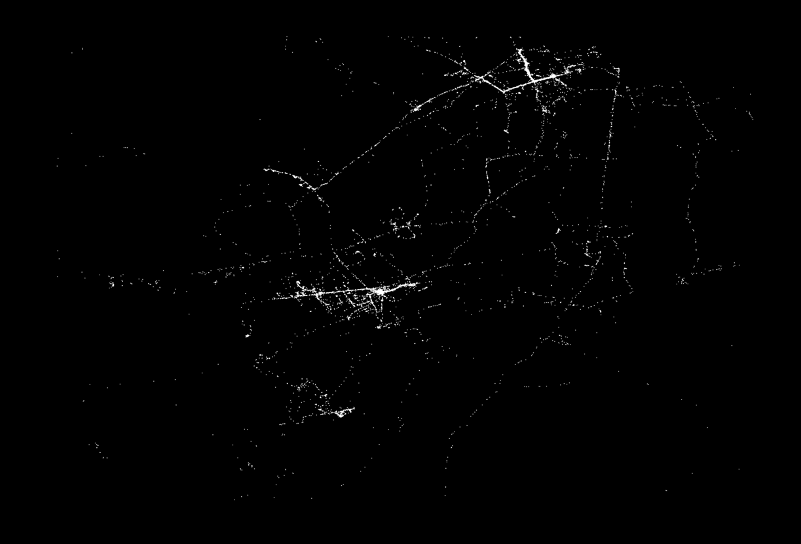
my london vs 2 googler friends’

Slide 33
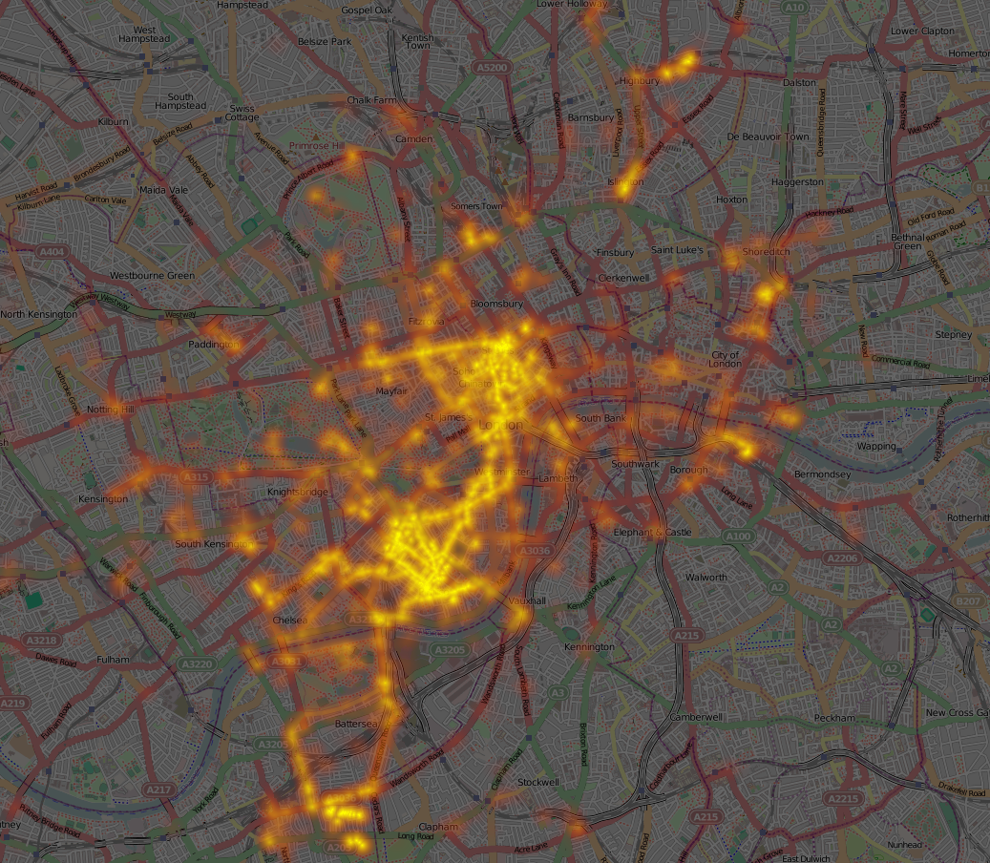
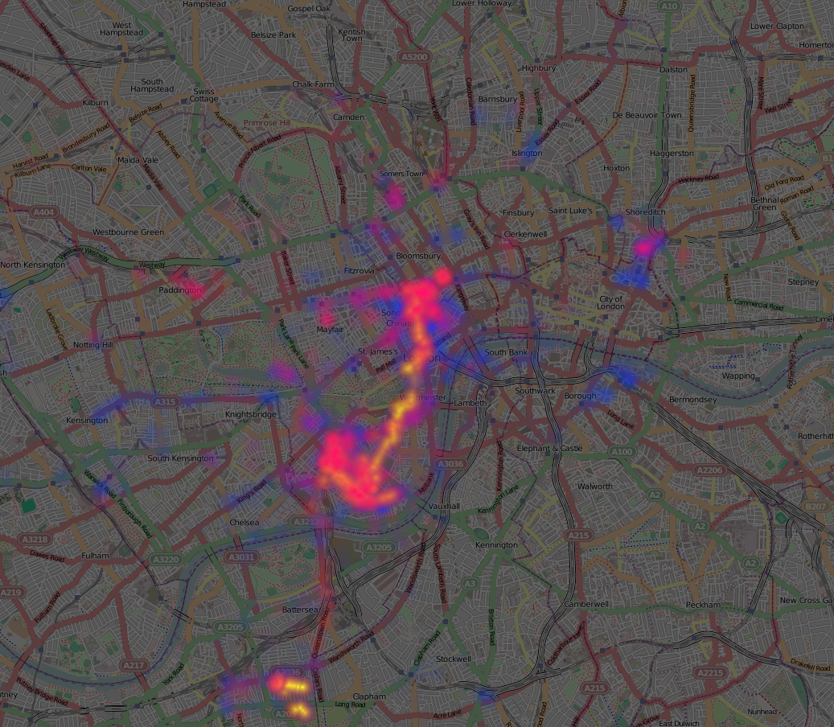
playing with some heatmap packages
Blue=evening, Red=working-hours, Yellow=morning

Slide 34
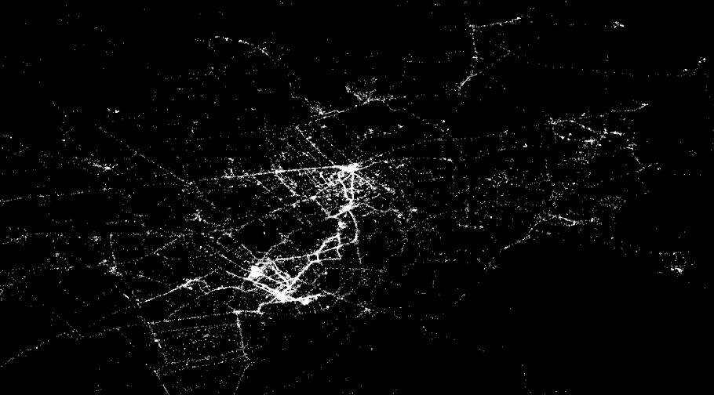
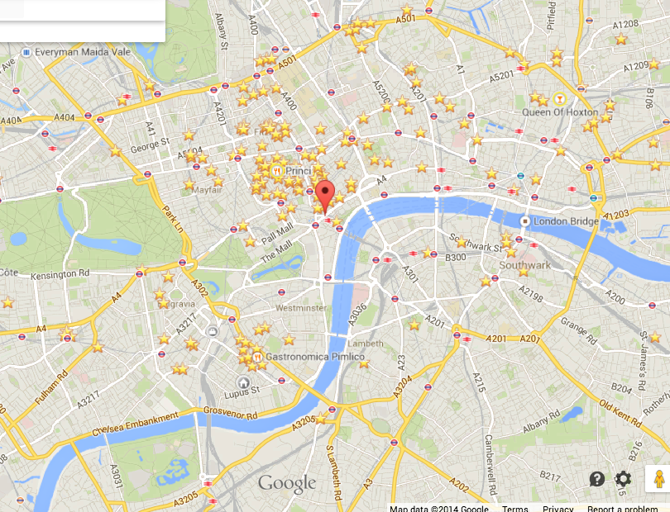
Upper
St
Kings X
Euston
Old St
Paddington
Work 1
Oxford St
Hyde Park
Trafalgar Sq
Green Park
London Bridge
Work 2
King’s Rd
Climbing
Home
Battersea Park

Slide 35
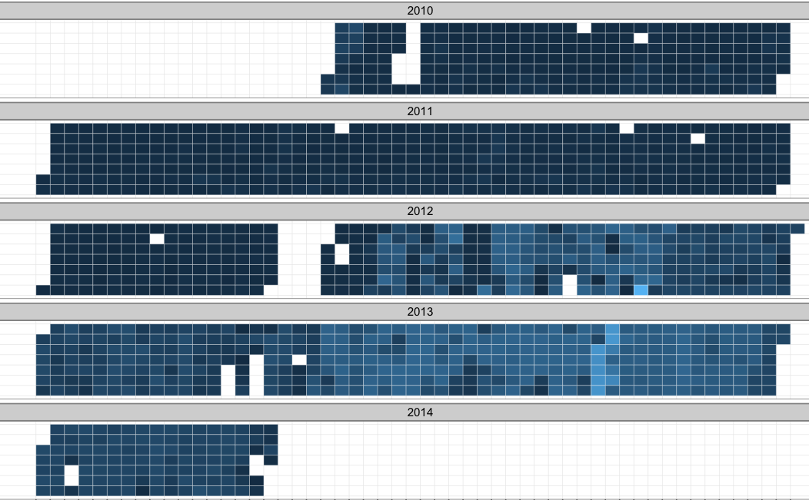
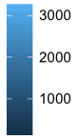
Monday
Tuesday
Wednesday
Thursday
Friday
Saturday
Sunday
Monday
Tuesday
Wednesday
Thursday
Friday
Saturday
Sunday
Monday
Tuesday
Wednesday
Thursday
Friday
Saturday
Sunday
Monday
Tuesday
Wednesday
Thursday
Friday
Saturday
Sunday
Monday
# data points per day
Tuesday
Wednesday
Thursday
Friday
Saturday
1000
2000
3000
Sunday

Slide 36
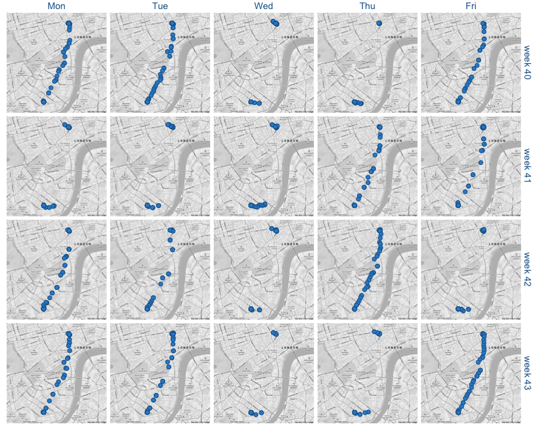

visualisation of my commute. quite clearly shows when I take the tube (e.g. Wednesdays) vs walk
more heatmap exploration

